Slide 1
Assignment on Monochrome TV Receiver
Submitted To
Name :Imran Hossain
Assistant Professor
Department of ICT,
Comilla University
Submitted by
Name :Rejwan Ahmed
ID :11809036
Session :2017-18
Department of ICT,
Comilla University

Slide 2
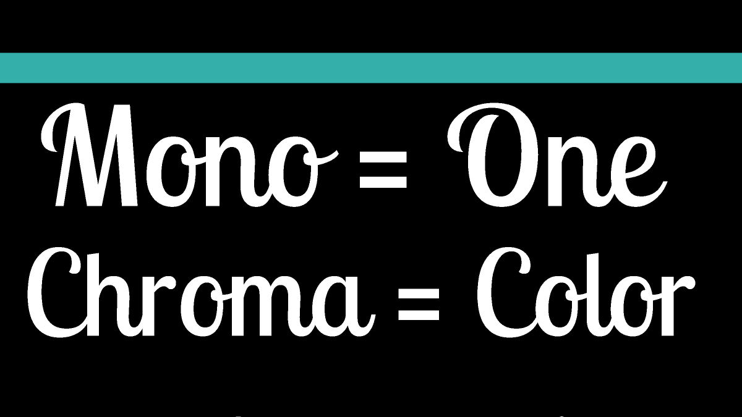

Slide 3
Basics of Monochrome TV Receiver
Data transmitted by Monochrome TV transmitter antenna will be received by Monochrome TV receiver.
Here,our agenda is
Receive EM signal by Antenna at Rx,
Convert that into Electrical signal,
Separate sound and video signals
Play sound by speaker and play video by tube
In Monochrome TV,display will be black and white with the shades of gray.

Slide 4
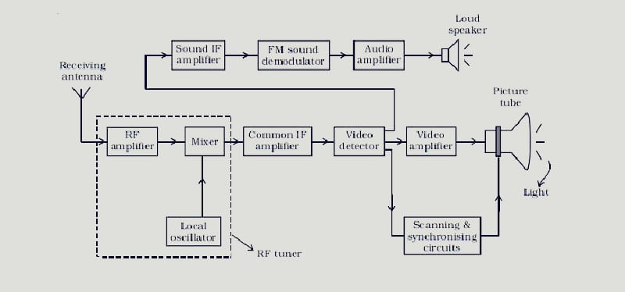
Block Diagram of Monochrome TV Receiver

Slide 5
Audio section
The receiving antenna intercepts radiated RF signals and the tuner selects the desired channel frequency band. The antenna provides RF picture and sound signals for the RF amplifier stage.
The RF amplifier stage is then coupled into the mixer stage. The mixture is connected to the local oscillator.
The RF audio and video signals are heterodyned into intermediate frequency by the mixer and local oscillator.
The output signal from the tuner circuit is amplified by using a common IF amplifier.
Then the video and audio components are separated by a detector.
The sound signals are detected from FM waves, amplified and then fed into the loud speaker, which reproduce the sound.

Slide 6
Video section
The video components are first passed into a detector which separates the picture signal from the synchronising pulses.
The line synchronising pulses and the frame synchronising pulses are fed into the horizontal and vertical deflector plates of the picture tube.
The picture signals are applied to the filament of the electron gun of the picture tube.
Thus, the intensity of the fluorescent screen of the picture tube is in accordance with the variation of potential in the picture and the picture is reproduced.

Slide 7
Parameters of Monochrome TV Receiver
It has a video information,in between black and white with the shades of gray.
It receives channels in the VHF and UHF.
Picture and sound signals are demodulated from RF carrier received from antenna.

Slide 8
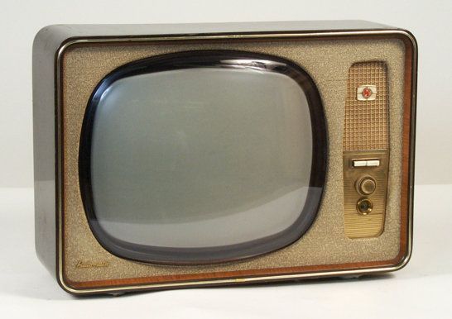
Black & White TV

